Slide 1
Biotic

Slide 2
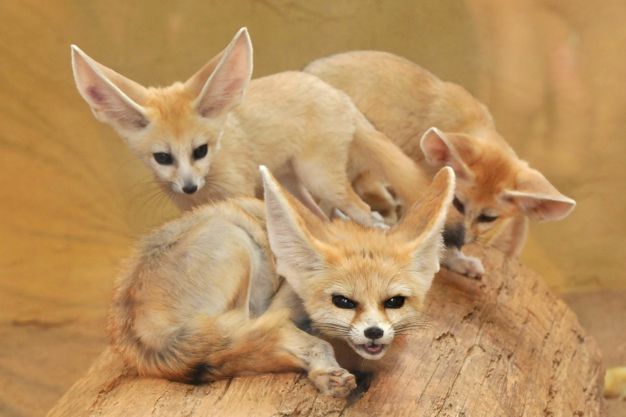
Fennec Fox

Slide 3
Cactus

Slide 4
Honey badger

Slide 5
African fish eagle

Slide 6
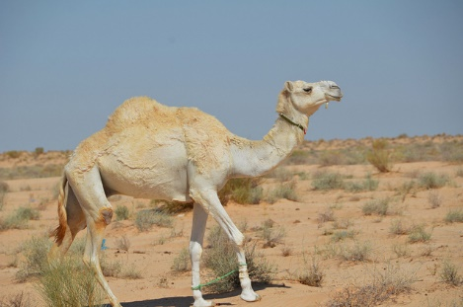
Humpback camel

